Slide 1
Using Apprentice
Presenter
Developer Technical Services

Slide 2
Agenda
Apprentice Definition
Apprentice Functionalities
Guidelines
Apprentice vs. Inventor: Differences
Saving Files with Apprentice

Slide 3
Apprentice
Add-In
Client App
Inventor Application
Client App
Add-In
VBA
Apprentice
Inventor Data

Slide 4
Apprentice Server
Apprentice is an ActiveX component.
Runs In-process with the client using it.
Apprentice Server provides a subset of the Inventor API.
Can be used standalone (doesn’t require Inventor).
Provided at no cost (installed as part of Inventor View).
Apprentice can be very efficient for certain tasks in comparison of connecting to Inventor out-of-process.
Notes:
The simple way to think of Apprentice is that it's a smaller version of Autodesk Inventor that does not have a user interface. Without a user interface the only way to access its functionality is by using its API. Apprentice is actually an ActiveX component. It runs within the process space of the client that's using it.
Apprentice can be very efficient for certain applications because it's smaller than the complete Autodesk Inventor application and because it runs in the same process as your application.

Slide 5
Apprentice Functionalities
Provides read-only access to:
Assembly structure
B-Rep
Drawing sheets and views (limited access)
iParts
iAssemblies
BOM
Provides read / write access to iProperties, attributes, and file references.

Slide 6
Apprentice - Guidelines
Should NOT be used in-process to Inventor.
Not in an Add-In (exe type of Add-In is ok).
Not through Inventor’s VBA.
Prior to Inventor 11, Apprentice was the only way to edit file references. (Design Assistant is build on top of Apprentice.)
Prior to 2008, the Apprentice functionalities were provided in its own type library.
Now Autodesk Inventor type library contains all of the Apprentice functionality Add a reference to Inventor.Interop for an Apprentice project.
Notes:
In past releases of the product, a type library specifically for Apprentice was delivered with both Autodesk Inventor and Apprentice. This type library contained the limited set of objects supported only by Apprentice. Now, however, since the Autodesk Inventor type library contains all of the Apprentice functionality, this should be used in an Apprentice context. A version of the old Apprentice type library is still supplied for legacy reasons, but this will likely be discontinued in future releases.

Slide 7
Apprentice vs. Inventor: differences
Instantiated using “new ApprenticeServerComponent”
No Documents collection in Apprentice
Document object:
ApprenticeServerDocument (*.ipt &*.iam)
ApprenticeServerDrawingDocument (*.idw)
Apprentice cannot save a file from a previous version, i.e. that is not migrated. You will need to migrate the file prior to save it with Apprentice: To migrate a file, open it with Inventor, save it and close it.
Notes:
When ApprenticeServer.Open opens a document, a reference to that document is held by the ApprenticeServer component in order to be returned from the ApprenticeServer.Document. This ‘active top/last opened’ document is also considered the document used as the root of the save for the FileSaveAs object. A document is closed when either ApprenticeServerDocument.Close is called, or the document’s reference count fully drops to zero. Keep in mind that the reference held by the ApprenticeServer (if it was the last document to be opened) also counts as a reference. This ApprenticeServer reference will be released either when a different document is opened, or ApprenticeServer.Close is called, or when the ApprenticeServer’s reference count fully drops to zero and it is destroyed.
The ApprenticeServerComponent supports a few methods and properties that are unique to Apprentice. These are the Open and Close methods, which are used to open and close documents within Apprentice; DisplayAffinity, which is used to optimize the behavior of Apprentice for viewer applications; MinimizeFileSize, which compresses files by removing versions, and FileSaveAs, which we'll discuss in more detail later in this section.
The document objects used within Apprentice are different from the document objects used in Autodesk Inventor. In Inventor there are the PartDocument, AssemblyDocument, DrawingDocument, and PresentationDocument objects. In Apprentice, the ApprenticeServerDocument object represents the part, assembly, and presentation documents and the ApprenticeServerDrawingDocument represents the drawing document.

Slide 8
Apprentice - Example
Private Sub ApprenticeSample()
' Create Apprentice.
Dim oApprentice As ApprenticeServerComponent
oApprentice = New ApprenticeServerComponent
' Open a document.
Dim oDoc As ApprenticeServerDocument
oDoc = oApprentice.Open("C:\Temp\Part.ipt")
MsgBox("Opened: " & oDoc.DisplayName)
End Sub

Slide 9
Saving Files with Apprentice
Use FlushToFile if the iProperties ONLY were modified: more efficient, since the document is not written back.
Private Sub SetProperty(ByVal author As String)
Dim oApprenticeDoc As ApprenticeServerDocument
oApprenticeDoc = mApprenticeServer.Open("c:\Temp\MyPart.ipt")
'Get "Inventor Summary Information" PropertySet
Dim oPropertySet As PropertySet
oPropertySet = oApprenticeDoc.PropertySets("{F29F85E0-4FF9-1068-AB91-08002B27B3D9}")
'Get Author property
Dim oProperty As Inventor.Property = oPropertySet.Item("Author")
oProperty.Value = author
oApprenticeDoc.PropertySets.FlushToFile()
oApprenticeDoc.Close()
End Sub

Slide 10
Saving Files with Apprentice
For any other change use FileSaveAs object:
Private Sub SaveFileSample()
Dim oApprentice As New ApprenticeServerComponent
' Open a document.
Dim oDoc As ApprenticeServerDocument
oDoc = oApprentice.Open("C:\Temp\Assembly1.iam")
' Do some change: iProperties and attributes and/or file references.
' Set a reference to the FileSaveAs object.
Dim oFileSaveAs As FileSaveAs
oFileSaveAs = oApprentice.FileSaveAs
' Save the file.
Call oFileSaveAs.AddFileToSave(oDoc, oDoc.FullFileName)
Call oFileSaveAs.ExecuteSave()
End Sub

Slide 11
Inventor View Control
Viewer for Inventor files
Provided as
32bit OS: <Inventor Installation>\bin\ InventorViewCtrl.ocx
64bit OS:<Inventor Installation>\bin\bin32\ InventorViewCtrl.ocx
Free (also provided with Inventor View)
Before Inventor 2012, InventorViewCtrl.ocx was registered automatically with product
Starting from 2012, the registry-free was introduced. So plug-in developers have to link the corresponding manifest files to their application if they want to use the OCX. Two options:
1. Use mt.exe to generate manifest file by yourself and link the manifest file to your application.
2. Use old style. But you have to register InventorViewCtrl.ocx manually by running “Regsvr32 InventorViewCtrl.ocx”.

Slide 12
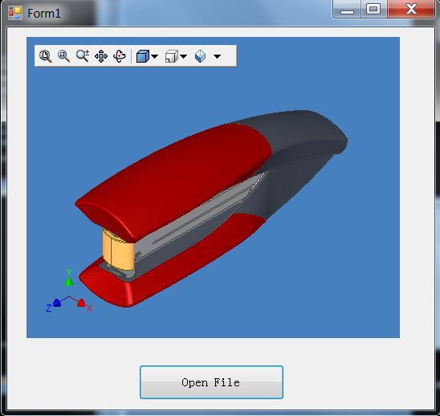
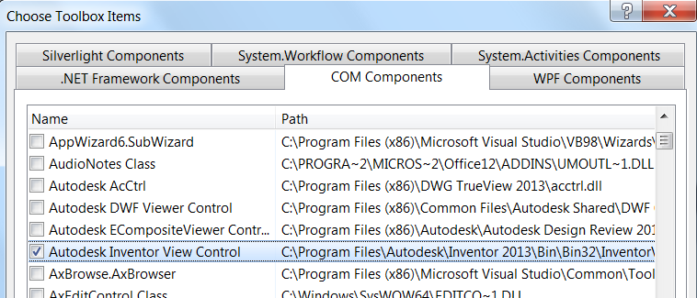
Inventor View Control
Note: To work with Inventor View control of 2013, please use framework 3.5

Slide 13
Transient Camera
Previously, the only way to get a camera is from a View.
Create images without a view. Useful in Apprentice
Private Function GetImage(ByVal Filename As String) As Image
' Create an instance of Apprentice.
Dim apprentice As New Inventor.ApprenticeServerComponent
' Open the specified file.
Dim appDoc As Inventor.ApprenticeServerDocument = apprentice.Open(Filename)
' Create a camera.
Dim cam As Inventor.Camera = apprentice.TransientObjects.CreateCamera
' Associate the camera with the part's component definition.
cam.SceneObject = appDoc.ComponentDefinition
' Set the camera to the desired orientation and position.
cam.ViewOrientationType = Inventor.ViewOrientationTypeEnum.kIsoTopRightViewOrientation
cam.Fit()
cam.ApplyWithoutTransition()
' Create an image. Can also use SaveAsBitmap to save the image directly to a file in one of several formats.
Dim picDisp As stdole.IPictureDisp
picDisp = cam.CreateImage(1000, 1000)
' Return the image.
Return Microsoft.VisualBasic.Compatibility.VB6.IPictureDispToImage(picDisp)
End Function

Slide 14

Notes:
Thank you!
Questions?

